Slide 1

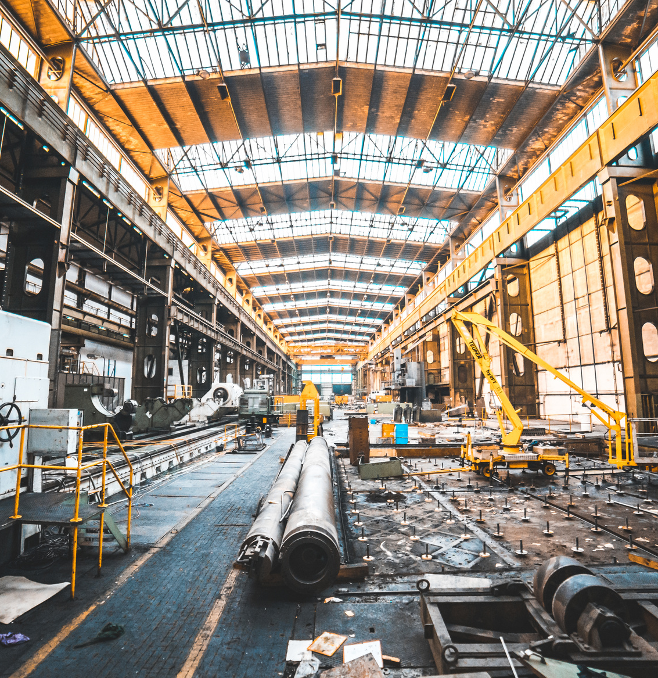
SMART MINING SAFETY HELMET
DONE BY : BYTE BRIGADE
FROM: SRI ESHWAR COLLEGE OF ENGINEERING, COIMBATORE.

Slide 2
PROBLEM STATEMENT :
Develop an innovative mining safety helmet with advanced features to enhance protection and communication for miners, promoting safer working conditions underground.
REASON WHY WE TOOK THIS PROJECT :
Recently, in Uttarakhand, nearly 40 miners have been trapped inside. In this situation, there seems to be a lack of communication between those inside and outside the mine, and there was no landslide alert either. Therefore, we have proposed the following solutions to address these issues:
1. Establishing a robust communication system between the trapped miners and the rescue teams outside.
2. Implementing a landslide alert system to prevent such incidents in the future.

Slide 3
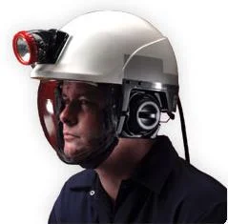
OUR SOLUTION
01
Hazard Monitoring: Constantly watches temperature, pressure, and gas levels for safety.
02
Lora Communication: Ensures reliable miner-surface communication.
03
Real-time Tracking: Provides precise miner location tracking with Lora.
04
Instant Alerts: Quickly notifies miners of emergencies via Lora.
05
Enhanced Safety: Uses accelerometer sensors for advanced hazard monitoring, including fall detection
06
Health Monitoring: Monitors health with pulse sensors
07
Electrical Insulation: Guards against shocks in hazardous areas.
08
Thermal camera : Thermal camera is used to monitor the live movements of the miners.

Slide 4
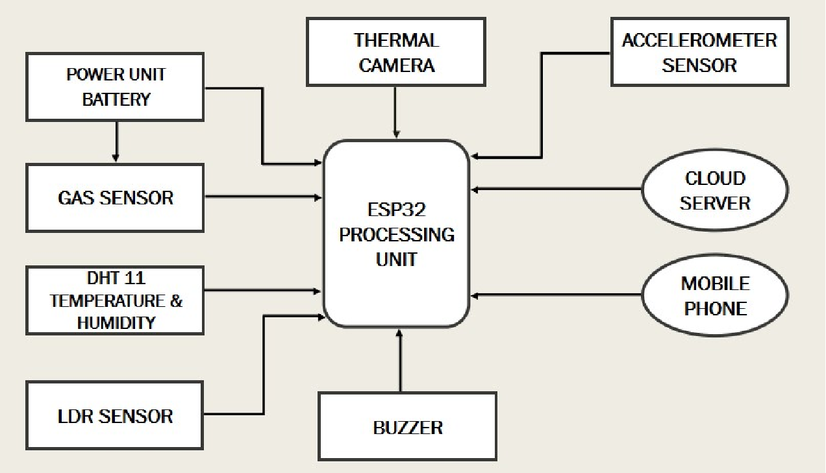
BLOCK DIAGRAM :

Slide 5
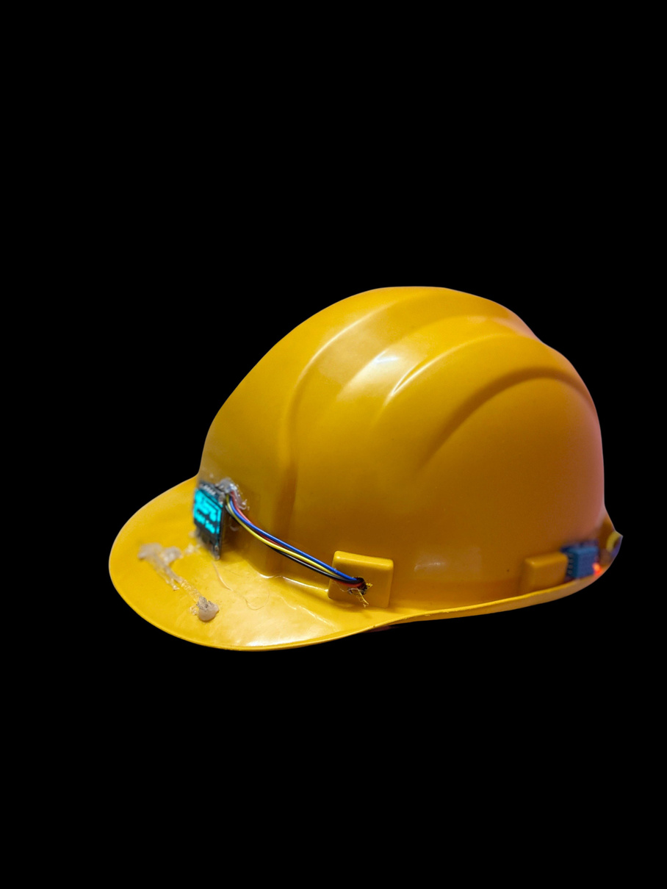

HARDWARE USED :
ESP8266
ACCELEROMETER
LORA COMMUNICATION
PULSE RATE SENSOR
DHT11
GAS SENSOR MQ2
LDR SENSOR
OLED DISPLAY
RF TRANSMITTER
RF RECEIVER
SOFTWARE USED:
FRONT END : HTML, CSS,JS,PHP, #C
BACK END : MYSQL
TOOL: VS CODE

Slide 6
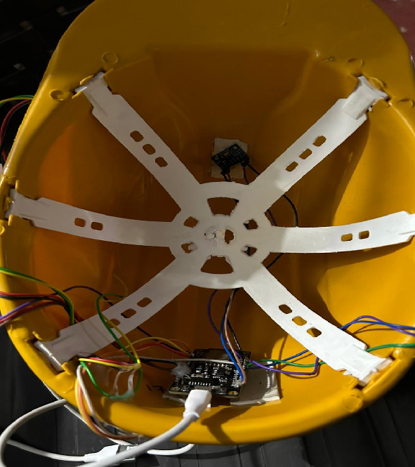
PROTOTYPE OF ULT﻿IMATE MINING HELMET
1.Accelerometer sensor detects movement and triggers buzzer alert for land shakes.
2. Gas and LDR sensors monitor oxygen levels and detect fires.
3. Miners can send messages to a server for help in emergencies.
4. Pulse rating sensor monitors miners' health and alerts to potential risks.
5. Designed to enhance safety and communication in mining environments.
6. Equips miners with tools for safer underground work.

Slide 7
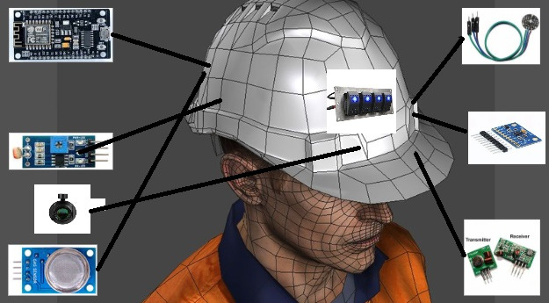
AI VIEW OF MINING HELMET
MODULE 1

Slide 8
EXPLANATION OF THE SAFETY HELMET :
Installation of sensors:
1. Accelerometer: to detect any land shake.
2. LDR (Light Dependent Resistor): to monitor ambient light levels.
3. Gas sensors: to measure levels of methane, carbon monoxide, and oxygen inside the mine.
4. Pulse monitoring sensor: placed near the ear of each miner to monitor their heart rate.
Alert system:
1. If a miner's heart rate reaches a critical level, the pulse monitoring sensor will immediately send information to the server, along with the miner's live location.
2. In case of a land shake, the accelerometer will measure its intensity, and a buzzer will sound to alert the miners.
Communication system:
1. Use of LORA (Long Range) communication frequency to determine the miners' location underground.
2. Implementation of LORA communication technology to enable communication between the miners and the server, as WiFi and Bluetooth communication are not feasible underground.

Slide 9
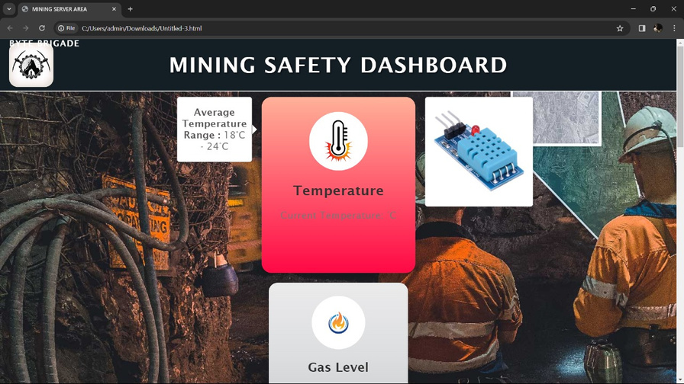
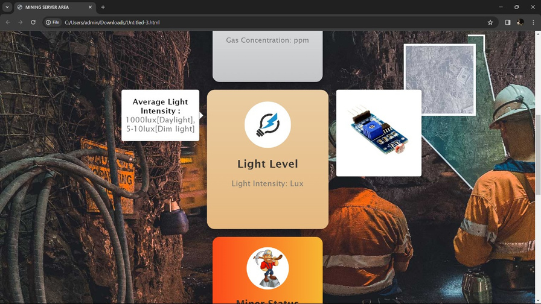
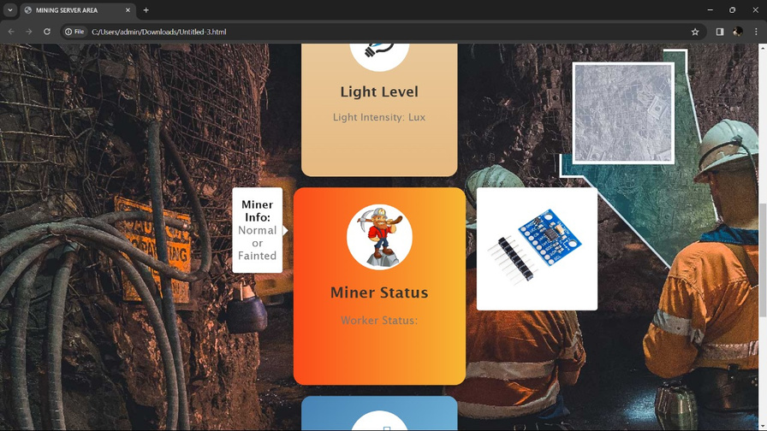
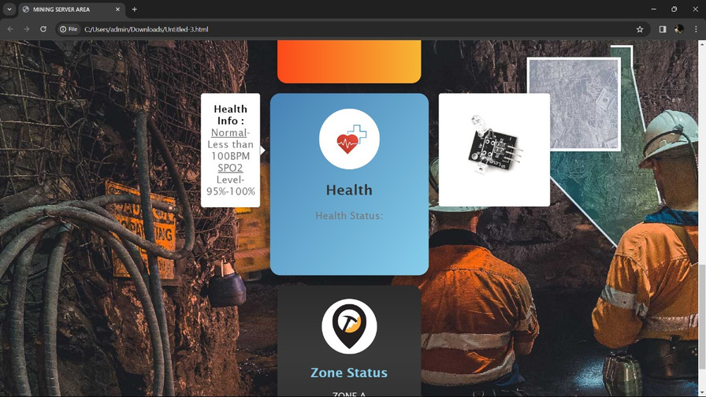
SERVER DASHBOARD

Slide 10
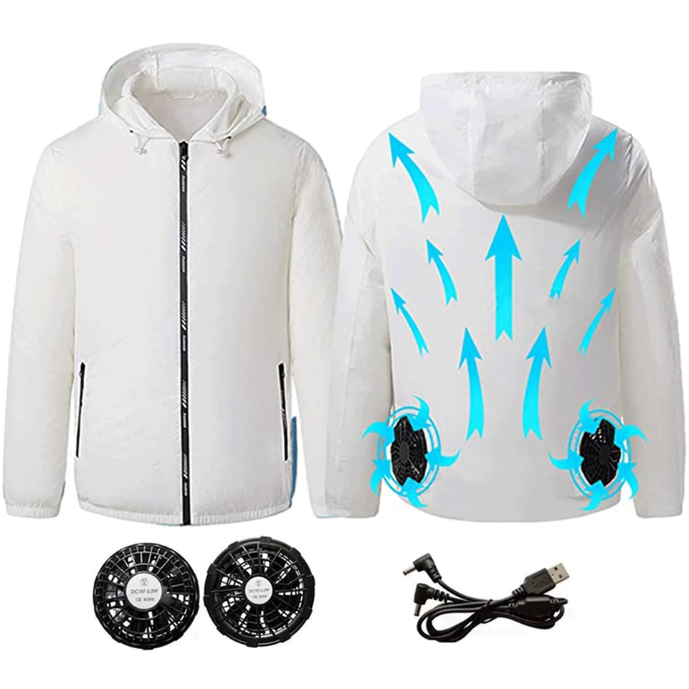
COOLING JACKET
1.Cooling jacket designed for miners to regulate body temperature.
2. Features detachable fans for customizable airflow.
3. Includes a 10000mAh power bank for extended use.
4. Utilizes low power consumption for efficient operation.
5. Provides comfort and safety for workers in mining environments.

Slide 11
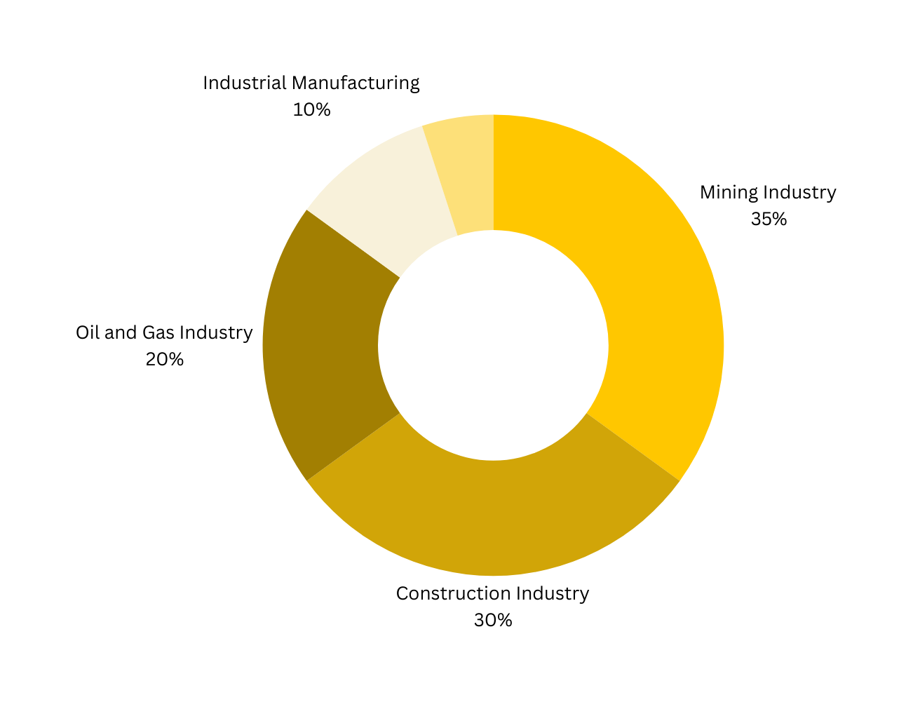
TARGET MARKET :
MINING INDUSTRY
CONSTRUCTION INDUSTRY
OIL AND GAS INDUSTRY
INDUSTRIAL MANUFACTURING
UTILITIES

Slide 12
THANK YOU

